Slide 1
The Innovation Project
Presented to you by Mountain Shredders

Slide 2
#1
INTRODUCTION
This is a presentation on the problems of archeology. It involves the process of how archaeologists work, how we can improve it, and our solution to this problem that you will see on the next slide. Sit back, relax as we give this presentation on how we can change archeology for the better.

Slide 3
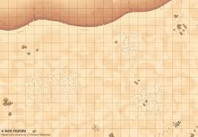


#2
The BIG Problem
They have to map out a grid in a certain area and then spend much time that they could’ve used for identifying stuff to dig and search.
Where could it be?

Slide 4
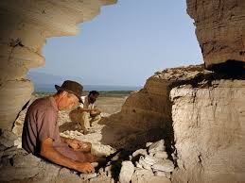
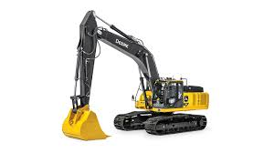

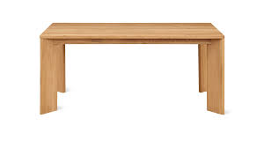
Another issue
#3
Lack of good digging capabilities.
Too much effort is being put into manual effort and not enough being put into research
I spent too much effort digging now i cant do my research!
Old artifact research

Slide 5




Weather : Blazing hot
#4
The climate is getting hotter every year and that is extremely bad for archeologists. Soil is wet/damp from nearby lakes or rivers but when it gets hot the water evaporates from the ground and the soil becomes more harder to dig, so more work is put into digging and they get tired so they don't get much done or it takes a really long time.

Slide 6
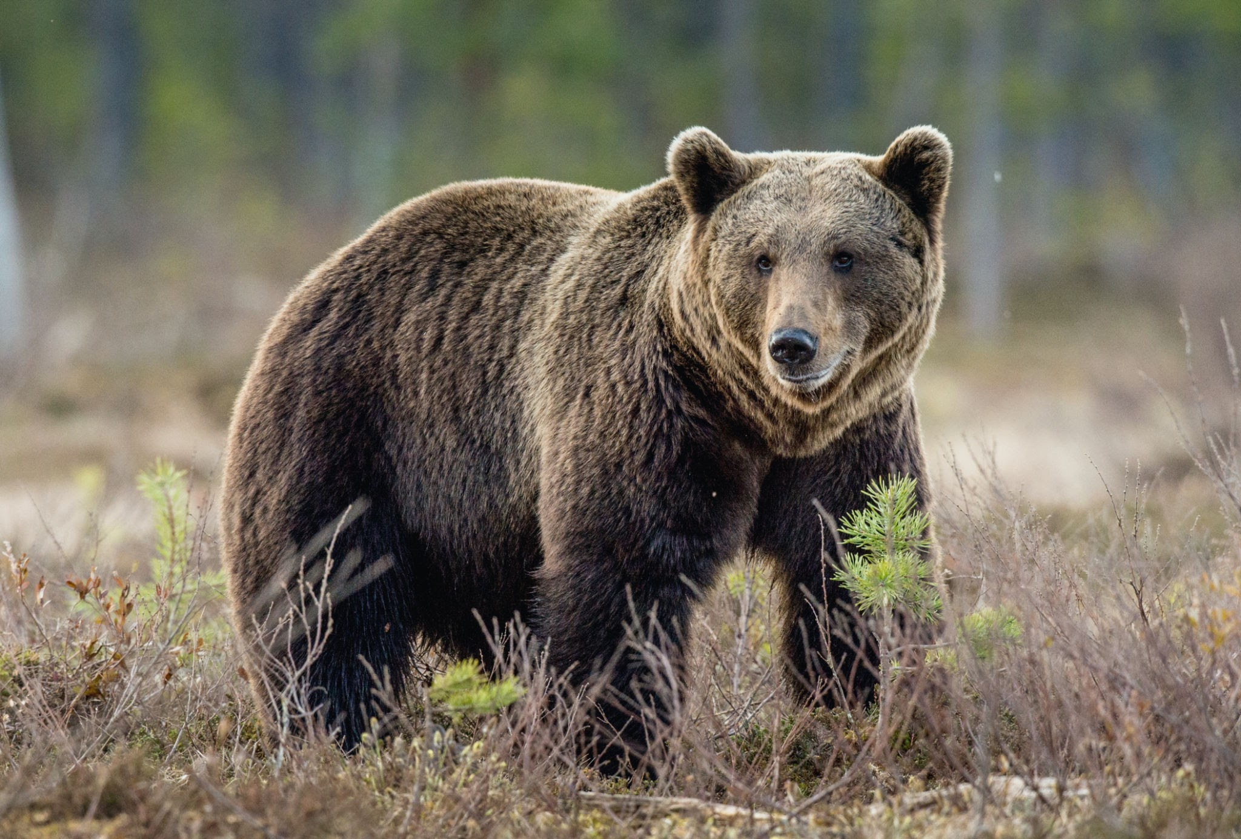
Animal/Wildlife Dangers
#5
Archeologists face many dangers while digging in suburban places where humans haven't been in a while & wildlife has taken over . For example, fatal creatures such as snakes, spiders, scorpions, bears, and cougars will endanger humans.
*roar*
AHH A BEAR!

Slide 7
OUR SOLUTION
#6
Our solution is a coded driving robot that wanders digging areas that hold possible artifacts.
The Robot Includes:
ground penetrating radar (GPR) to detect artifact
Fine tipped digging arms that dig until it's 5” above the detected artifact.

Slide 8
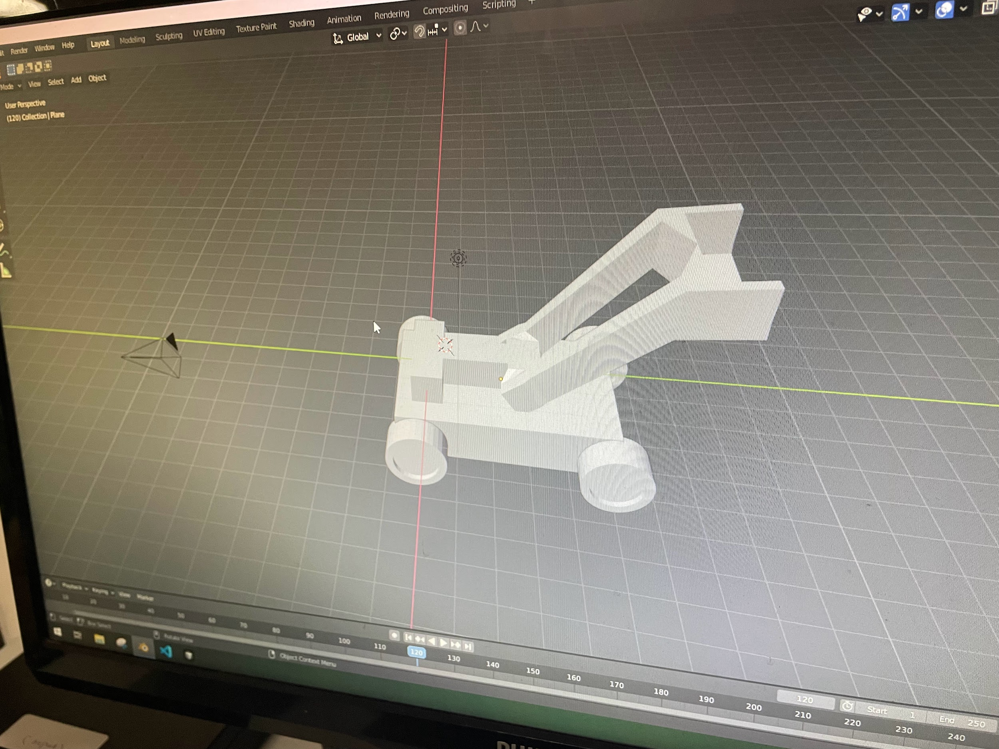
Our first idea Made by Manthon
#7
Motor
Digging arm
Hub
Wheels

Slide 9
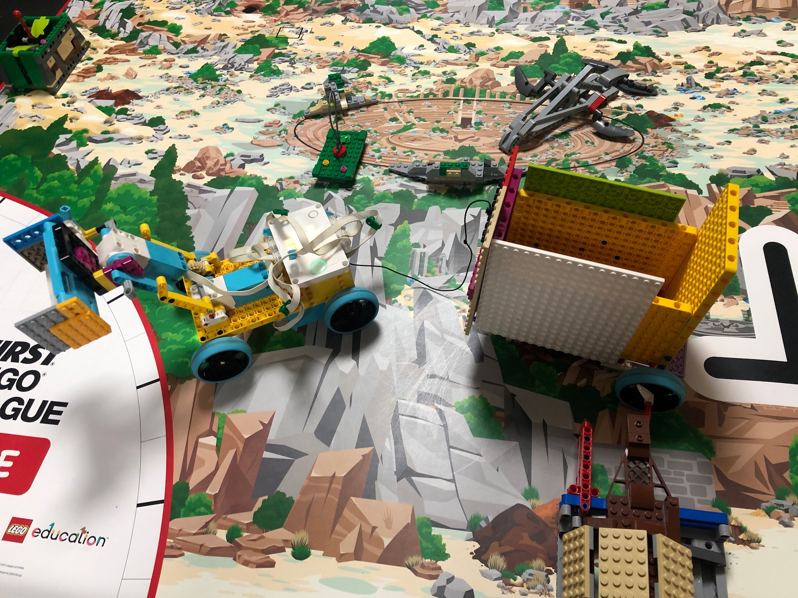
Our Prototype
#8
Digging arm! ( Made by Kesler )
GMCS ( Made by sid)
(Ground Material Containment System)
GPR ( Made by Kesler)

Slide 10
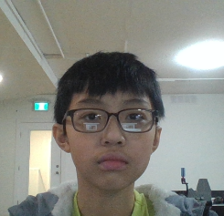
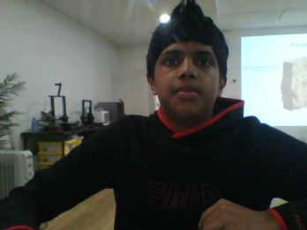
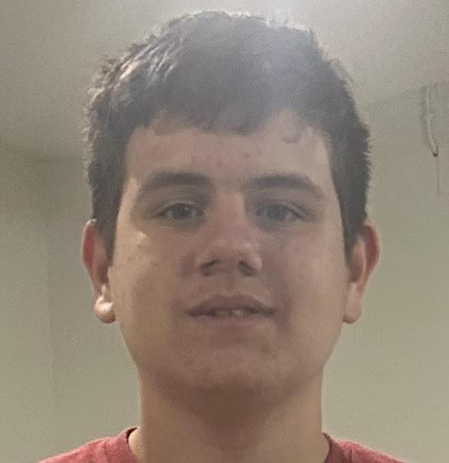
Team mountain Shredders
#9
Manthon
Sid
Kesler

Slide 11

The end
We will be happy to answer any questions you may have.

